Slide 1

RUNGTA COLLEGE OF DENTAL SCIENCES & RESEARCH
TOPIC – ODONTOGENIC CYST
DEPARTMENT OF
DEPARTMENT OF ORAL PATHOLOGY AND MICROBIOLOGY

Slide 2
Objectives
Definition
Classification
Discussion of various odontogenic cyst

Slide 3
Contents
Definition
Classification
Odontogenic keratocyst
Gingival cyst of new born
Gingival cyst of adults
Lateral periodontal cyst
Dentigerous cyst
Eruption cyst

Slide 4
Odontogenic cysts

Slide 5
Definition
A cyst is a pathological cavity having fluid, semifluid or gaseous contents & which is not created by the accumulation of pus. It is frequently, but not always, lined by epithelium. (Kramer 1974)

Slide 6
Classification

Slide 7
STS OF THE JAWS
CY
A.
EPITHELIAL
Developmental
a) Odontogenic
1.
i)
Odontogenic Keratocyst (Primordial cyst)
ii) Gingival cyst of infants
iii)
Gingival cyst of adults
iv) Eruption cyst
v)
Dentigerous (follicular)
vi)
Lateral periodontal cyst
vi) Botryoid odontogenic Cyst
vii)
Glandular Odontogenic Cyst
viii)
Calcifying Odontogenic Cyst

Slide 8
b) Non-odontogenic
Nasopalatine duct (incisive canal) cyst
Nasolabial (nasoalveolar) cyst
Midpalatal raphe cyst of infants
I
v) Median palatine, median maxillary and median mandibular cysts
v) Globulomaxillary cysts

Slide 9
2. Inflammatory
Radicular cyst
Residual cyst
Paradental cyst and mandibular infected buccal cyst
Inflammatory collateral cyst

Slide 10
B. Non-Epithelial
Solitary bone cyst (traumatic, simple, hemorrhagic bone
cyst)
Anurysmal bone cyst

Slide 11
Odontogenic Keratocyst

Slide 12
First described by Mikulicz, 1876 → “Dermoid cyst”
Hauer, 1926 → “Cholesteatoma”
Robinson, 1945 → “Primordial cyst”
  The terminology has been discarded
Philipsen, 1956 → “Odontogenic Keratocyst”
Because of its potential aggressive behavior some researchers have suggested that OKC is a benign cystic neoplasm and recently the name “Keratocystic Odontogenic Tumor” has been suggested

Slide 13
Pathogenesis
Robinson, 1945 → derived from enamel organ by degeneration of stellate reticulum before any calcified structure has been laid down → Primordial cyst
Evidence against this theory
  Frequency of aplasia of teeth is relatively higher than that of keratocysts
  Site distribution of these cysts and supernumerary teeth is different

Slide 14
Remnants of dental lamina
Origin from overlying oral epithelium as basal cell hamartias

Slide 15
Clinical features
Frquency
  11.2% of all jaw cysts
Age
  Bimodal age distribution
    2nd and 3rd decade
    Second peak in 5th and 6th decade
Sex
  Male preponderance

Slide 16
Site
  Mandible most frequent (75%)
  Almost half of keratocysts occur at the angle of
mandible

Slide 17
Clinical presentation
  Remarkably free of symptoms until the cyst have reached a large size
  Pain, swelling or discharge
  Pathologic fracture
  Maxillary cysts → more likely to become infected → diagnosed earlier
  Displacement of teeth

Slide 18
Other
  Displacement and destruction of the floor of orbit
  Proptosis of eyeballs
  Neurological symptoms
“Peripheral OKC” → cysts occuring outside the bone
Multiple cysts with or without naevoid basal cell carcinoma syndrome

Slide 19
Radiological features
Small, round or ovoid, radiolucent areas
Sometimes more extensive
Well demarcated with distinct sclerotic borders
Unilocular or multilocular
May have scalloped margins
Expansion is seen late and may be buccal or lingual

Slide 20
Can mimic
  Radicular cyst
  Dentigerous cyst → follicular primordial cyst
  Lateral periodontal cyst
  Nasopalatine duct cyst
Radiographically classified into 4 types (Main, 1970)
  Replacement
  Envelopmental
  Extraneous
  Collateral

Slide 21
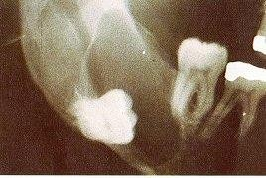
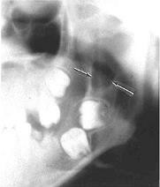
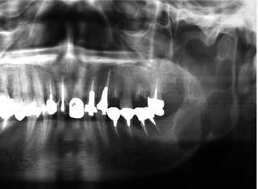
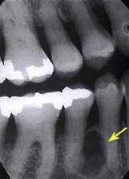
Replacement
Envelopmental
Collateral
Extraneous
25

Slide 22
Histopathology
Regular keratinized stratified squamous epithelium
5-8 cell layer without rete ridges
Corrugated surface
Well defined, palisaded basal layer
  Columnar
  Nuclei → away from basement membrane and intensely basophilic
Suprabasal cells → polyhedral and often show intercellular edema

Slide 23
Mitotic activity → more in suprabasal layer
  Higher in patients with syndrome
Epithelial dysplasia
Fibrous capsule
  usually thin with relatively few cells
  stroma rich in mucopolysaccharide and
resembles mesenchymal connective tissue

Slide 24
Inflammatory cells
  infrequent
  mild infiltration of lymphocytes and monocytes
intense inflammation
epithelium looses its keratinised surface
thicken & develop rete processes or may ulcerate

Slide 25
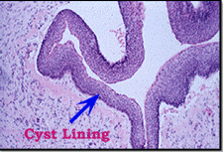
collapsed and folded thin-walled cysts
erroneous impression of multilocularites in
histological section

Slide 26
Gingival cyst and midpalatal cyst of infants

Slide 27
Clinical features
Frequently seen in new born infants
Rare after 3 months of age
  Undergo involution and disappear
  Rupture through the surface epithelium and exfoliate
Along the mid palatine raphe → Epstein’s pearls
Buccal or lingual aspect of dental ridges → Bohn’s
nodules

Slide 28
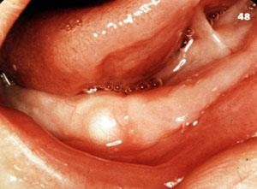
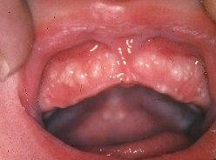
❐ 2-3 mm in diameter
White or cream coloured
Single or multiple (usually 5 or 6)

Slide 29
Pathogenesis
Gingival cyst of infants
Arise from epithelial remnants of dental lamina (cell rests of Serre)
These rests have the capacity to proliferate, keratinize and form small cysts

Slide 30
Midpalatal raphe cyst
Arise from epithelial inclusions along the line of fusion of palatal folds and the nasal process
  Usually atrophy and get resorbed after birth
  May persist to form keratin filled cysts

Slide 31
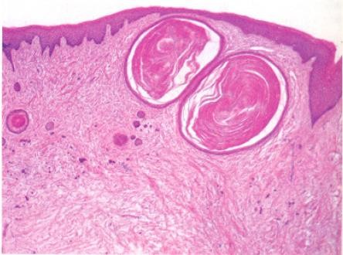
Histopathology
Round or ovoid
Smooth or undulating outline
Thin lining of stratified squamous epithelium with parakeratotic surface
Cyst cavity filled with keratin
(concentric laminations with flat nuclei)
Flat basal cells
Epithelium lined clefts between cyst
and oral epithelium
Oral epithelium may be atrpohic

Slide 32
Gingival cyst of adults

Slide 33
Clinical features
Frequency
  0.5%
  May be higher as all cases may not be submitted to histopathological examination
Age
  5th and 6th decade
Sex
  No predilection
Site
  Much more frequent in mandible
  Premolar-canine region

Slide 34
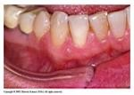
Clinical presentation
Soft and fluctuant
Well circumscribed, slowly enlarging, painless swelling
Attached gingiva or interdental papilla
Facial aspect
Usually less than 1 cm
Smooth surface
Colour of overlying mucosa → normal or bluish
Adjacent teeth usually vital
Slight erosion of surface of the bone

Slide 35
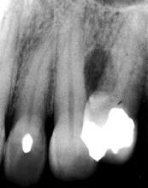
Radiological features
No change
Faint round shadow

Slide 36
Pathogenesis
Odontogenic epithelial cell rests
Traumatic implantation of surface epithelium
Cystic degeneration of deep projections of surface
epithelium
From glandular elements
Junctional epithelium
May be derived from reduced enamel epithelium

Slide 37
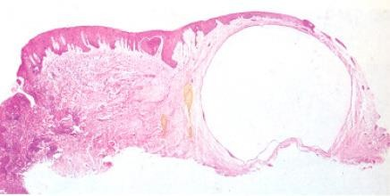
Histopathology
Extremely thin epithelium resembling REE
  1-3 layers of flat to cuboidal cells
  Darkly staining nuclei
Or
Thicker stratified squamous epithelium without rete ridges

Slide 38
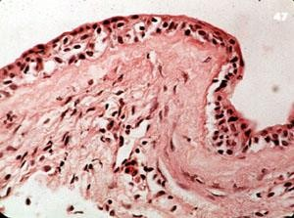
Epithelial cells may show
  Pyknotic nuclei
  Perinuclear cytoplasmic vacoulization
  Atrophic with ghost outlines
Localized epithelial thickenings or plaques
  Some protrude in the cystic lumen
  Some extend into fibrous cyst wall
  Cells
    Whorled configuration
    Compact and fusiform
    Swollen and clear (water clear cells)
Low columnar cells on the surface of epithelium →
origin from ameloblasts

Slide 39
Fibrous connective tissue wall
  Usually uninflamed
  Except close to junctional epithelium → chronic inflammatory cell infiltrate
  May contain epithelial islands

Slide 40
Lateral periodontal cyst

Slide 41
Cysts which occur in the lateral periodontal position and in which an inflammatory etiology and a diagnosis of collateral keratocyst have been excluded on clinical and histopathological grounds

Slide 42
Clinical features
Frequency
  0.7%
Age
  Prominent peak in the 6th decade
Sex
  No sex predilection
  Some studies show slight male preponderance
Site
  Mandibular premolar area
  Anterior maxilla

Slide 43
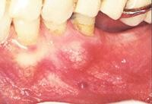
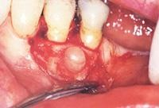
Clinical presentation
  Asymptomatic
  Gingival swelling on facial aspect
  Pain, tenderness on palpation
  Consistency
    Springy with egg shell crackling
    Gelatinous feel
  Associated teeth usually vital

Slide 44
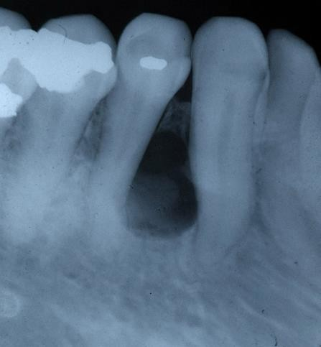
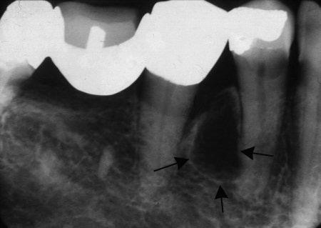
Radiographic features
Round or oval, well circumscribed radiolucency
Sclerotic margin
Between the apex and cervical
margin of tooth
Usually less than 1 cm in diameter
Mean growth → 0.7mm per year
(Rasmusson, Magnusson, Borrman, 1991)

Slide 45
Pathogenesis
Developmental odontogenic origin
Three possibilities
  Reduced enamel epithelium
  Remnants of dental lamina
  Cell rests of Malassez

Slide 46
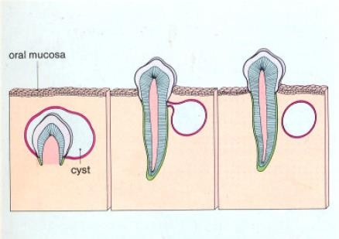
Reduced enamel
epithelium
  Arises initially as a dentigerous cyst developing by expansion of the follicle along the lateral surface of crown

Slide 47
Support of this hypothesis
  LPC occur in areas where dentigerous cysts are likely to be associated with vertically impacted teeth
  Epithelial plaques similar to those seen in LPC may also be seen sometimes in dentigerous cysts
  Cytokeratin 18 → strongly expressed in LPC & some dentigerous cysts (Hormia et al, 1987 & Heikinheimo et al, 1989)

Slide 48
Cell rests of dental lamina (Wysocki et al,
1980)
  Cystic change in a single rest → unicystic forms
  Concomitant changes in several adjacent rests →
polycystic
Support for this hypothesis
  Limited growth potential of LPC → derivation from post functional cells of dental lamina
  Glycogen containing clear cells seen in rests of dental lamina may also be seen in LPC

Slide 49
Cell nests of Malassez
  Occur in the periodontium
  Well positioned for a lateral periodontal cyst
  Has not received much support

Slide 50
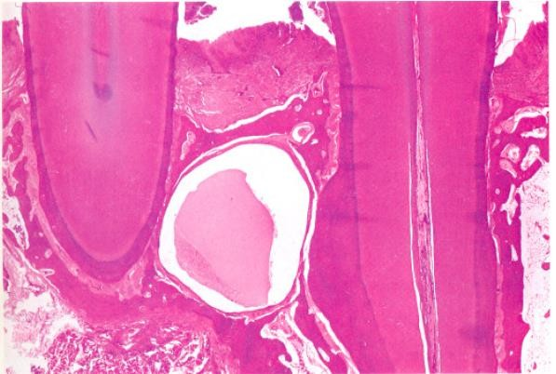
Histopathology
Thin, non-keratinized squamous or cuboidal epithelial lining
1-5 cell layers
Resembles reduced enamel epithelium
Sometimes stratified
squamous

Slide 51
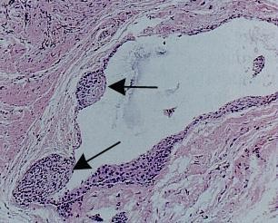
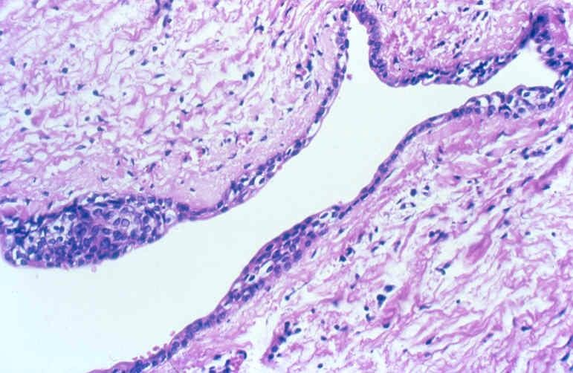
Localized plaques or thickenings of the epithelial lining
  Extend into the surrounding cyst wall
  Mural bulges
  Cells are some times fusiform with long axis parallal to basement membrane
  Cells of the plaque may differentiate to take a spinous shape
6
7

Slide 52
Small epithelial nests of follicles in the fibrous cyst wall
Epithelial lining may separate from the cyst wall
Areas of juxta-epithelial hyalinization of collagen
Usually free of inflammation

Slide 53
Dentigerous cyst

Slide 54
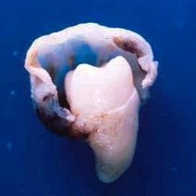
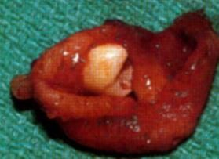
A dentigerous cyst is one which encloses the crown of an unerupted tooth by the expansion of its
follicle, and is attached to the neck

Slide 55
Clinical features
Frequency
  16.6%
Age
  Peak between 2nd-4th decade
  Most common jaw cyst in the first decade
Sex
  Male predilection (1.6: 1)
Race
  More common in whites

Slide 56
Site
  Mandibular third molar
  Maxillary canine
  Mandibular premolars
  Maxillary third molars
  Others
  Supernumerary teeth
    Mesiodens → 90%

Slide 57
Clinical presentation
  May be asymptomatic
  Slowly enlarging swelling
  Painful if infected

Slide 58
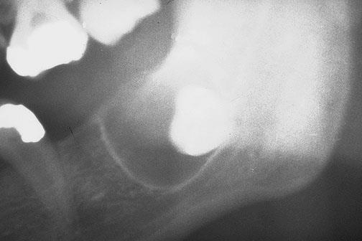
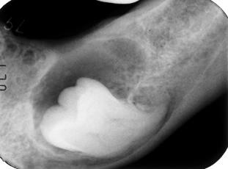
Radiographic features
Unilocular radiolucent area associated with crown of an unerupted tooth.
Erroneous impression of multilocularity

Slide 59
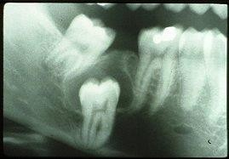
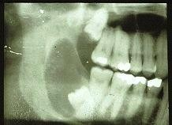

Slide 60
Three variants
  Central
  Lateral
  Circumferential

Slide 61
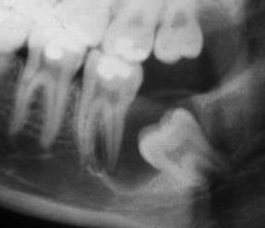
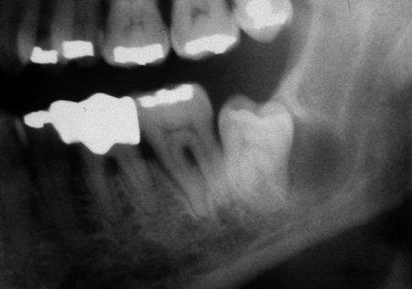
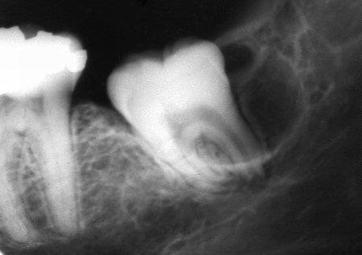
Central
Lateral
Circumferential
Prof. Shaleen Chandra
31

Slide 62
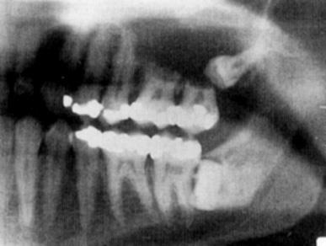
Greater tendency to produce root resorption
  Derivation from dental follicle
  Release of bone resorbing factors from the cyst wall
    Prostaglandins E2 and E3
    Interleukin 1
    TNF

Slide 63
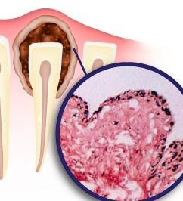
Pathogenesis
Intrafollicular
  Develop by accumulation of fluid betwee
    Reduced enamel epithelium and enamel
    Within the enamel organ itself i.e cystic degeneration of stellate reticulum
Extrafollicular
  Envelopmental or follicular keratocysts???
n

Slide 64
Enamel hypoplasia
  Cyst arising from degeneration of stellate reticulum →
enamel hypoplasia
  Cyst arising from accumulation of fluid between REE and enamel → no enamel hypoplasia

Slide 65
Presence of enamel hypoplasia
Diminished the adherence of REE to the crown
Accumulation of fluid Cyst formation

Slide 66
Superficial cells of the cyst lining sometimes show projections resembling Tomes’ process
Derived from ameloblasts
Origin from REE

Slide 67
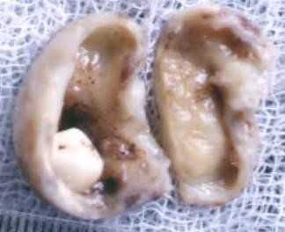
Histopathological features
Thin fibrous cyst wall derived from dental follicle
  Young fibroblasts
  Abundant stroma and ground substance rich mucopolysachharides
in acid

Slide 68
Epithelial lining derived from REE
  2-4 layers of flat cuboidal cells
  Characteristically non keratinized
  May have discontinuities
  Sometimes superficial layers may be low columnar →
retains morphology of ameloblast layer

Slide 69
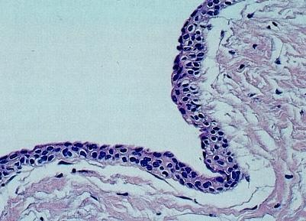
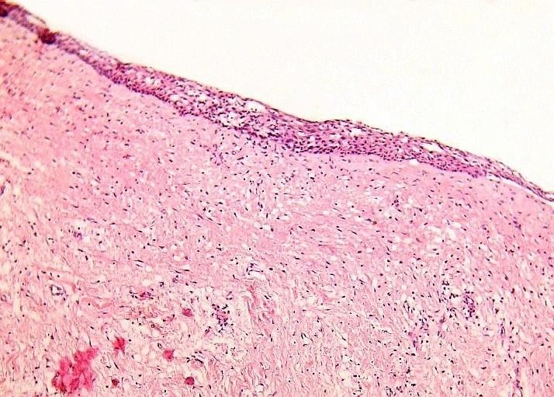

Slide 70
Variations
  Mucous cells in epithelial lining
    More common in maxilla
  Ciliated cells in epithelial lining
  Sebaceous glands in cyst wall

Slide 71
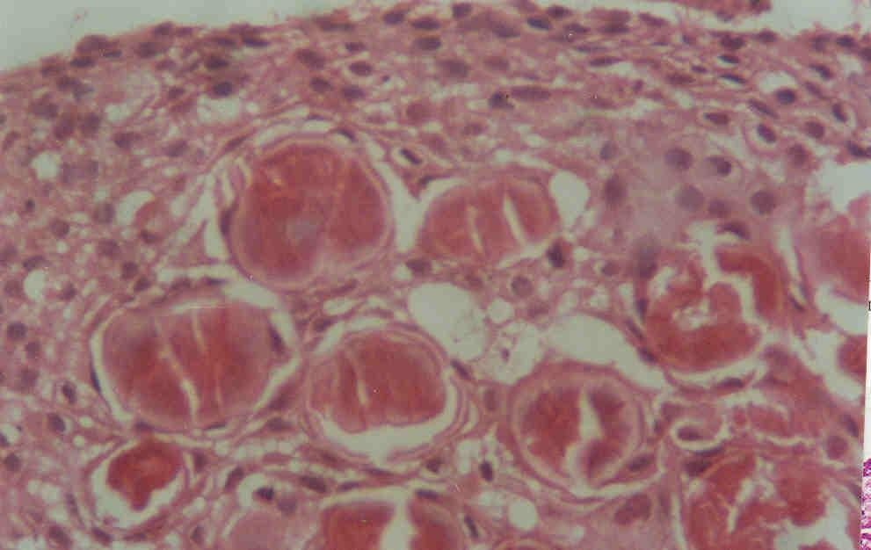
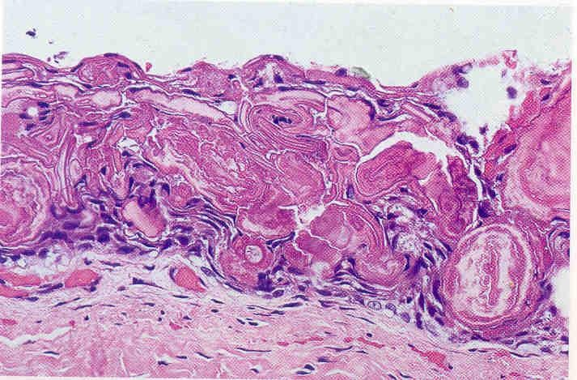
Rushton bodies
  Found within
    The epithelium or its surface
    Connective tissue wall
  Appear as
    Irregular, eosinophilic, glassy structures
    Often showing a granular
center

Slide 72
Localized proliferation of epithelial lining in response to inflammation
Bud-like thikenings of the epithelium in absence of inflammation
Budding of the basal cells into the fibrous capsule
Epithelial proliferations resembling SOT

Slide 73
Eruption cyst

Slide 74
Dentigerous cyst occurring in the soft tissues
Occurs when tooth is impeded in eruption within the soft tissues

Slide 75
Clinical features
Frequency
  0.8%
Age
  Children of different ages
  Occasionally adults → delayed eruption

Slide 76
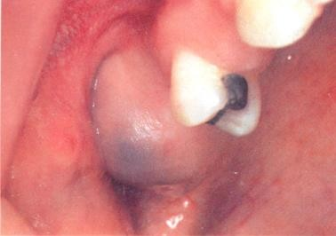
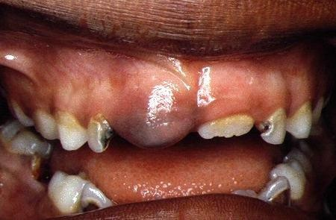
Clinical presentation
  Most frequently anterior to the
1st permanent molar
  Smooth swelling over erupted tooth
  Normal colour or bluish
  Soft and fluctuant
  Usually painless unless infected

Slide 77
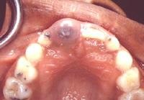
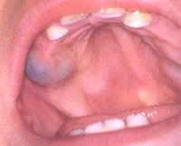

Slide 78
Sometimes more than one cyst may be present
Brief history of about 3-4 weeks
Usually 1-1.5 cms

Slide 79
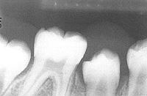
Radiographic features
May have a soft tissue shadow
No bone involvement

Slide 80
Pathogenesis
Similar to dentigerous cyst
Dense fibrous soft tissue may be responsible for impedance in eruption

Slide 81
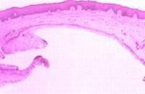
Histopathological features
Superficial aspect covered by
gingival epithelium
Cyst is lined by REE
Intensly inflamed → may form arcades
Connective tissue capsule merges with gingival connective tssue
  Gingival connective tissue → pink
  Cyst connective tissue → blue

Slide 82
Take home message
Odontogenic cyst are epithelial lined pathologic cavities and surrounded by fibrous connective tissue
Cystic condition of the jaw cause bony destruction and may cause resorption or displacement of adjacent teeth

Slide 83
Question & Answer Session
DENTIGEROUS CYST
RADIOGRAPHIC FEATURES OF LATERAL PERIODONTAL CYST
DEFINE CYST. WRITE IN BRIEF ABOUT ODONTOGENIC CYST
Students should be given opportunity to ask question for clarifying for their understand/ confusions. Teachers must spend 5-10 minutes for this to improve the output.

Slide 84
References
Lucas
Shafer
Neville
Regezi
84

